Slide 1

Noida Institute of Engineering and Technology, Greater Noida
Mobile Application Development
ACSIOT0401
Unit: I
INTRODUCTION TO MOBILE APPLICATION AND ARCHITECTURE
Vatika Jalali
Assistant Professor
IoT Department
4th Semester
(IoT)

Slide 2







Faculty Profile
Responsibilities
Faculty IoT,
Mentor IoT
Research Interests
Digital Image processing,
Machine Learning
Ms. Vatika Jalali
Assistant Professor, IoT
Education
M.Tech CSE, PTU
B.Tech CSE, HPTU
Publications
Research Paper: 4
Work Exp.
NIET, Gr. Noida (September, 2022 to till date)
Worked at Chandigarh University
Ms. Vatika Jalali Mobile Application Development Unit-1

Slide 3
Evaluation Scheme
Sl. No. | Subject Codes | Subject Name | Periods |  |  | Evaluation Scheme |  |  |  | End Semester |  | Total | Credit
 |  |  | L | T | P | CT | TA | TOTAL | PS | TE | PE
1 | AAS0402 | Engineering Mathematics- IV | 3 | 1 | 0 | 30 | 20 | 50 |  | 100 |  | 150 | 4
2 | AASL0401 | Technical Communication | 2 | 1 | 0 | 30 | 20 | 50 |  | 100 |  | 150 | 3
3 | ACSE0403B | Operating Systems | 3 | 0 | 0 | 30 | 20 | 50 |  | 100 |  | 150 | 3
4 | ACSAI0402 | Database Management Systems | 3 | 1 | 0 | 30 | 20 | 50 |  | 100 |  | 150 | 4
5 | ACSIOT0401 | Mobile Application Development | 3 | 0 | 0 | 30 | 20 | 50 |  | 100 |  | 150 | 3
6 | ACSE0404 | Theory of Automata and Formal Languages | 3 | 0 | 0 | 30 | 20 | 50 |  | 100 |  | 150 | 3
7 | ACSE0453B | Operating Systems Lab | 0 | 0 | 2 |  |  |  | 25 |  | 25 | 50 | 1
8 | ACSAI0452 | Database Management Systems Lab | 0 | 0 | 2 |  |  |  | 25 |  | 25 | 50 | 1
9 | ACSIOT0451 | Mobile Application Development Lab | 0 | 0 | 2 |  |  |  | 25 |  | 25 | 50 | 1
10 | ACSE0459 | Mini Project using Open Technology | 0 | 0 | 2 |  |  |  | 50 |  |  | 50 | 1
11 | ANC0402 / ANC0401 | Environmental Science*/ Cyber Security*(Non Credit) | 2 | 0 | 0 | 30 | 20 | 50 |  | 50 |  | 100 | 0
 |  | MOOCs** (For B.Tech. Hons. Degree)
 |  | GRAND TOTAL |  |  |  |  |  |  |  |  |  | 1100 | 24
Ms. Vatika Jalali Mobile Application Development Unit-1

Slide 4
Syllabus
Course Contents / Syllabus
UNIT-I | Introduction to Mobile Application and Architecture | 8 Hours
Mobile applications, History of mobile application frameworks, Characteristics and types of mobile applications, Achieving quality constraints. Mobile Architecture- Mobile Hardware Architecture: processors used for Mobile and Handheld devices and SoC architecture; Mobile Software Architecture: Real Time Operating systems and Mobile Real Time Operating Systems, SDK’s.
UNIT-II | Android Developing Environment | 6 Hours
Introduction to Android, Android ecosystem, Android SDK and Installation, Layered Architecture of Android, Android API levels (versions & version names), Android Development Tools, Basic Building blocks – Protocols, Activities, Services, Broadcast Receivers & Content providers.
UNIT-III | UI Components and Multimedia | 10 Hours
Fundamental UI design, layout and view types, Interaction with server-side applications – Using Google Maps, GPS and Wi-Fi, Integration with social media applications, Interfacing sensor data with mobile application, Accessing applications hosted in a cloud computing environment. Multimedia Supported audio and video formats, Audio capture, Bluetooth, Animation.
Ms. Vatika Jalali Mobile Application Development Unit-1

Slide 5
Syllabus
UNIT-IV | Android Application Deployment | 8 Hours
Persisting data using SQLite database, Testing and debugging Android Application, Packaging and Android Application Deployment on device with Windows, Android Permissions. Testing and publishing of Mobile Applications on different app stores.
UNIT-V | iOS and Swift | 8 Hours
Introduction to Objective C, iOS features, UI implementation, Touch frameworks, Data persistence using Core Data and SQLite, Location aware applications using Core Location and Map Kit, integrating calendar and address book with social media application, using Wifi - iPhone marketplace. Swift: Introduction to Swift, Features of swift.
Ms. Vatika Jalali Mobile Application Development Unit-1

Slide 6
Branch wise Applications
A mobile app is a medium between an IoT device and a mobile phone.
The app works as the primary interface through which we can manage smart things.
Mobile IoT apps supplement and enhance the use of IoT to make it work more efficiently.
Ms. Vatika Jalali Mobile Application Development Unit-1

Slide 7
Course Objective
This course introduces students to programming technologies, design and development related to mobile applications using android/ iOS.
Course also aims at mobile application development frameworks; mobile architecture, design and engineering issues, techniques, methodologies for mobile application development.
Ms. Vatika Jalali Mobile Application Development Unit-1

Slide 8


Course Outcomes
Course outcomes : After completion of this course students will be able to
CO 1 | Recall vision, definition, conceptual framework, architecture of mobile applications. | K1
CO 2 | Describe and configure android development environment, tools, and architecture. | K2
CO 3 | Create and implement UI components and multimedia framework, fragments, audio capture, animation, and other activities. | K6
CO 4 | Integrate and interact with server-side applications with testing and deployment of android application. | K3
CO 5 | Analyze iOS and swift features, frameworks, map kit, and social media applications. | K4
Ms. Vatika Jalali Mobile Application Development Unit-1

Slide 9
CO-PO Mapping
Mapping of Course Outcomes and Program Outcomes:
CO.k | PO1 | PO2 | PO3 | PO4 | PO5 | PO6 | PO7 | PO8 | PO9 | PO10 | PO11 | PO12
ACSIOT0401.1 | 3 | 3 | 1 | 3 | 2 | 1 | 1 | 3 | 1 | 2 | 2 | 2
ACSIOT0401.2 | 3 | 3 | 2 | 3 | 3 | 2 | 3 | 3 | 2 | 2 | 3 | 2
ACSIOT0401.3 | 3 | 3 | 2 | 3 | 3 | 3 | 3 | 3 | 2 | 2 | 3 | 3
ACSIOT0401.4 | 3 | 3 | 2 | 3 | 2 | 1 | 1 | 3 | 1 | 1 | 2 | 2
ACSIOT0401.5 | 3 | 3 | 2 | 3 | 3 | 2 | 3 | 3 | 2 | 2 | 3 | 2
Average | 3 | 3 | 1.8 | 3 | 2.6 | 1.8 | 2.4 | 3 | 1.8 | 1.8 | 2.6 | 2.2
3= High, 2=Medium, 1=Low

Slide 10
Result Analysis
Subject | No. of students | Min Marks | Max Marks | Over all Result
Mobile Application Development | 40 | 30 | 80 | 95%

Slide 11
Ge
End Semester Question paper Templates
General Instructions:
All questions are compulsory. Answers should be brief and to the point.
This Question paper consists of …………pages & …8………questions.
It comprises of three Sections, A, B, and C. You are to attempt all the sections.
Section A -Question No- 1 is objective type questions carrying 1 mark each, Question No- 2 is very short
answer type carrying 2 mark each. You are expected to answer them as directed.
Section B - Question No-3 is Long answer type -I questions with external choice carrying 6 marks each.
You need to attempt any five out of seven questions given.
Section C - Question No. 4-8 are Long answer type –II (within unit choice) questions carrying 10 marks
each. You need to attempt any one part a or b.
Students are instructed to cross the blank sheets before handing over the answer sheet to the invigilator.
No sheet should be left blank. Any written material after a blank sheet will not be evaluated/checked.

Slide 12
 |  | SECTION – A |  | CO
 | Attempt all parts- |  | [10×1=10]
 | 1-a. | Question- | (1)
 | 1-b. | Question- | (1)
 | 1-c. | Question- | (1)
 | 1-d. | Question- | (1)
 | 1-e. | Question- | (1)
 | 1-f. | Question- | (1)
 | 1-g. | Question- | (1)
 | 1-h. | Question- | (1)
 | 1-i. | Question- | (1)
 | 1-j. | Question- | (1)
2. | Attempt all parts- |  | [5×2=10] | CO
 | 2-a. | Question- | (2)
 | 2-b. | Question- | (2)
 | 2-c. | Question- | (2)
 | 2-d. | Question- | (2)
 | 2-e. | Question- | (2)

Slide 13
SECTION – B |  |  |  | CO
3. | Answer any five of the following- |  | [5×6=30]
 | 3-a. | Question- | (6)
 | 3-b. | Question- | (6)
 | 3-c. | Question- | (6)
 | 3-d. | Question- | (6)
 | 3-e. | Question- | (6)
 | 3-f. | Question- | (6)
 | 3-g. | Question- | (6)
SECTION – C |  |  |  | CO
4 | Answer any one of the following- |  | [5×10=50]
 | 4-a. | Question- | (10)
 | 4-b. | Question- | (10)
5. | Answer any one of the following-
 | 5-a. | Question- | (10)
 | 5-b. | Question- | (10)
6. | Answer any one of the following-
 | 6-a. | Question- | (10)
 | 6-b. | Question- | (10)
7. | Answer any one of the following-
 | 7-a. | Question- | (10)
 | 7-b. | Question- | (10)
8. | Answer any one of the following-
 | 8-a. | Question- | (10)
 | 8-b. | Question- | (10)

Slide 14
Prerequisites
Overview of programming language
JAVA and XML.

Slide 15
Brief Introduction about MAD with videos
Mobile application development is the process of creating software applications that run on a mobile device, and a typical mobile application utilizes a network connection to work with remote computing resources.
Hence, the mobile development process involves creating installable software bundles (code, binaries, assets, etc.) , implementing backend services such as data access with an API, and testing the application on target devices.
https://www.youtube.com/watch?v=bOiCw-ZZlGA
https://www.youtube.com/watch?v=09TeUXjzpKs&t=5270s

Slide 16
Unit Contents
Introduction to mobile
Mobile Applications
History of mobile application framework
Characteristics of mobile applications
Types of mobile applications
Achieving quality constraints
Introduction to mobile architecture
Mobile Hardware Architecture: processors used, SoC architecture
Mobile Software Architecture: RTOS and MRTOS
SDK’s

Slide 17
Unit Objective
To understand key concepts of mobile app development.
To know the opportunities and challenges of mobile apps.
To know the details of PC based apps as well as web based apps.
To know the content and key protocols of mobile apps
To know the evolution of mobile apps
To understand the software and hardware architecture

Slide 18
Introduction to Mobile
Topic objective: To understand about the mobile and types
Mobile : Modified Operation Byte Integration Limited Energy
Phone : Personal Handset Over Network Equipment
A Mobile phone is a portable Microcomputer and also a portable communication device.
Mobile is also a portable device, portable device means that you can move a mobile phone from one place to another very easily.
A mobile phone is a multitasking device.

Slide 19
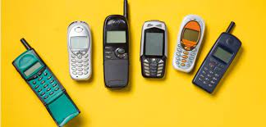
Introduction to Mobile
There are three types of mobile phones.
Cell Phones
Feature Phones
Smartphones
1. Cell Phones
When the mobile phone was newly launched, the mobile phone was also known as the cell phone at that time.
Cell phones were used to basically receive phones and to call a person. Apart from this, cell phones were used to send text messages and read messages.
At that time cell phones used to be very expensive and limited.

Slide 20
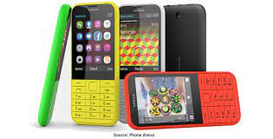
Introduction to Mobile
2. Feature Phones
Feature phones are also like cell phones. In addition to calls and messages on feature phones, you can also listen to mp3 songs, watch mp4 videos. On the feature phone, you can also use the internet, you can also play video games on it.
There was also Bluetooth in the feature phone so that you can share any kind of your data with others.

Slide 21
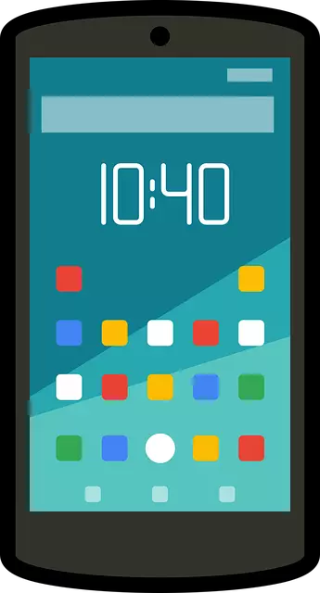
Introduction to Mobile
3. Smartphone
Smartphones are also like cell phones and feature phones.
With this phone having many smart features, this phone becomes a smartphone.
With the introduction of the Android operating system and ioS in the smartphone, this phone became a very popular and best-selling phone.
Today you can use 5G internet speed in a smartphone and this speed is being increased even more. Which you can use a 7G internet speed.
Today in a smartphone, you get the touch-screen, Wi-Fi connectivity, HD cameras, and data streaming, watch HD video, shoot HD video, and more features available in these smartphones.
These smartphones are more expensive than cell phones and feature phones.

Slide 22
Introduction to Mobile
Mobile is an adjective word. Let's understand the meaning of each word of mobile.
M = Modified - Modified means a change in the form and quality of a device. As the mobile phone's design and its features change from day to day.
O = Operation - Operation means the process of modification or improvement of the mobile devices is called an operation.
B = Byte - Byte means storage. Byte is a low storage unit 8 bits is equal to 1 byte.
I think you are having some difficulty in understanding - read this post, your problem will go away.
I = Integration - The action or process of developing a mobile device is an integration. integration is related to mathematics.
L = Limited - Limited means small in size and there was a very small number of mobile phones when the mobile was launched.
E = Energy - Mobile is an energy-powered device. The mobile device runs on cell energy. The mobile cell is charged with electricity

Slide 23
Mobile Applications
A mobile application or app is a computer program or software application designed to run on a mobile device such as a phone, tablet, or watch.
Many apps require Internet access. Apps are generally downloaded from app stores, which are a type of digital distribution platforms.
The 6 types of mobile apps are:
Educational apps.
Lifestyle apps.
Social media apps.
Productivity apps.
Entertainment apps.
Game apps.

Slide 24
Mobile Applications
Topic objective: To understand about the mobile applications
Mobile applications are part of main stream digital strategy for Business to Consumer (B2C) enterprises.
Most of the enterprises are now adopting “mobile-first” strategy wherein the digital applications are designed, developed and tested for mobile devices; mobile users attain the primary focus in the digital strategy.
Disruption in mobility space has major impact on the revenues for the enterprises.
Mobile apps are shaping user experiences and are providing real-time information and offer more engaging experiences for the users.
Mobility based digital strategy considers various things such as user experience, performance, interactivity, device form factors, device limitations, location needs and personalization.

Slide 25
Mobile Applications
Mobile application development involves the process of developing the applications for mobile devices such as Personal Digital Assistants (PDA), tablets and smart phones and other mobile devices.
Native mobile apps are designed to run on a specific mobile platform, sometimes specific mobile operating system and supported hardware.

Slide 26
DAILY QUIZ 1
What is full form of MOBILE.
Name the types of mobile apps.
What is mobile-first strategy.
Name the devices you use on daily basis that are mobile.

Slide 27
Key Drivers for Mobile Applications
Topic objective: To understand about the market scenario related to mobiles
Innovation in mobile space such as proliferation of smart phones, higher bandwidths offered by 3G (Third generation) and 4G (Fourth generation) technologies are coupled with higher capacity storage technologies with higher speed chips would keep powering mobile devices.
Consumer behavior: Customers are more used to mobile devices and is easy for them to access information on the move.
Personalized content delivery: Enterprise can leverage the location and sensors to offer more contextualized, relevant and personalized content, offers and advertisements.
Mobile ecosystem: An explosive growth in Mobile Applications stores such as Apple store, Google Play store, Windows marketplace store was coupled with availability of games, utilities and other apps.
Social Networking: With the popularity of web 2.0 and social media technologies such as Facebook, Twitter users are increasingly using the location based features in the social media platforms.

Slide 28
Impact of Mobile Apps on various domains
Retail and Consumer Packaged Goods (CPG) Industry: Mobile apps provide location based store locator, targeted promotions/offers/coupons, service reminders, mobile bidding, in-store tools, cross sell/upsell tools and comparator tools. Basically, mobile apps play key role in driving the traffic, increasing the sales and drive the brand loyalty.
On B2B front, mobile apps have redefined lead management, CRM functions, efficient tracking, field force automation and such. Mobile apps have also lead to improvement in store merchandize, supply chain and inventory managements.

Slide 29
Banking industry: Mobile apps enable convenient ways to carry out transactions such as account balance, payment, localized alerts, tap-to pay, branch locator, and payment coupons. Mobile apps would also enable mobile banking, mobile wallet and provide “on-the-go” features.
Logistics: It is easier to track shipments, get updates, manage warehouse, and fleet using mobile apps.
Healthcare: Mobile apps can easily connect patients, doctors and insurance providers as well as provide wellness management solutions.
Impact of Mobile Apps on various domains

Slide 30
Attributes of Mobile Applications
Ubiquity: Mobile applications are always available and connected and enable users to access information anytime anywhere
User friendliness: Mobile applications provide responsive and interactive user interface with essential information. They utilize the camera, sensors, media output, touch/multi-touch/voice interface for providing simplified actionable information.
Location awareness: Mobile applications provide location sensitive information using Global Positioning System (GPS) and other sensors.
Minimalistic: The content and features in mobile apps are minimal which are essential for the functionality.

Slide 31
DAILY QUIZ 2
Mobile applications are always available and connected and enable users to access information anytime anywhere. Name the attribute
Mobile applications provide responsive and interactive user interface with essential information. (T/F)
Choose the key drivers for mobile application:
Innovation
Consumer Behavior
Patent
4. Mobile net banking feature is available on apps or not. Name the apps

Slide 32
Mobile Application Development Framework
Topic objective: To get aware about the development framework
A mobile development framework is a software framework that is designed to support mobile app development. It is a software library that provides a fundamental structure to support the development of applications for a specific environment.
Frameworks can be in three categories: native frameworks for platform-specific development, mobile web app frameworks, and hybrid apps, which combine the features of both native and mobile web app frameworks.

Slide 33
Mobile Application Development Framework
The Beginning
The Motorola DynaTAC 8000X in 1983 was the cellphone that started it all.
It paved the way for all other mobile phones, including the smartphones and apps that the users of today can’t live without.
While the giant brick of a phone could do little more than make calls, Nokia and other manufacturers decided to add more functionality by adding simple games such as Snake, Pong and Tic-Tac-Toe.
These apps were simple enough, but they played upon the popularity of games that were already on the market for game consoles. They also drastically changed how users thought about phones and opened the doors to app development. Naturally, it led to customers wanting more, but it would still be decades before app developers began delivering the variety of apps customers truly wanted.

Slide 34
Mobile Application Development Framework
The Beginning
At first, mobile users only had access to simple, though sometimes difficult to use, apps such as calculators, ringtone creators, basic arcade games and calendars. The sheer competition in the mobile market in the 80s and 90s meant mobile manufacturers carefully guarded their secrets and didn’t leave their platforms open for development. As a result, app development was in-house only.
Still, mobile companies tried to offer customers more apps via the Internet by using the Wireless Application Protocol (WAP). It was designed to address the problems 90s phones had, such as limited processing power, monochrome screens and little storage. While it seemed great to begin with, customers quickly saw the drawbacks, including apps limited to a single manufacturer’s apps, high usage charges and complex methods of actually receiving apps.
As more mobile devices hit the market, development costs dropped and some devices were using well-known platforms for app development, such as Linux and Windows. This opened the doors to a new generation of app development.

Slide 35
Mobile Application Development Framework
The Rise of Mobile Apps
By 1993, IBM attempted something new; a mobile device with a touchscreen. Simon, as it was named, included access to preinstalled apps for the tasks users wanted most, such as a calendar, clock, notepad, email, contacts, games and even fax. The easier to use device along with access to better looking apps made it extremely popular. RIM built upon this success with the first Blackberry that was dedicated to email, a still widely used app.
Users still wouldn’t truly get a taste of what they really wanted until 2007 and 2008 when Apple released the first iPhone followed by the App Store. Suddenly, users had access to an entire marketplace of apps that were easy to access and install.

Slide 36
Mobile Application Development Framework
Increase of Competition
By 2011, there were over one million apps available, and app usage finally surpassed mobile web usage. In the years that followed, Apple and Google saw their marketplaces’ popularity soar with over 15 billion downloads a piece.
Popular apps such as Draw Something and Instagram reached over 50 million downloads and the viral game, Angry Birds, has over one billion downloads.

Slide 37
Mobile Application Development Framework
Mobile Apps Today
Since the humble beginnings of a few crude arcade games, mobile apps have evolved and become a must-have to get things done quickly, and even waste a little time with fun games. Users are spending 87% of their time on apps while a mere 13% of the time is spent on mobile web.
In 2015, businesses are constantly being told to work on their mobile strategy, so much so that they are adopting a ‘mobile first’ approach. Not only are responsive websites essential for businesses, apps are also increasingly seen as a way for businesses to find new and exciting ways to change the lives of their customers. Customers who work from home, travel frequently and are always connected are looking for ways to access the things they need faster and easier, and mobile apps offer just that.

Slide 38
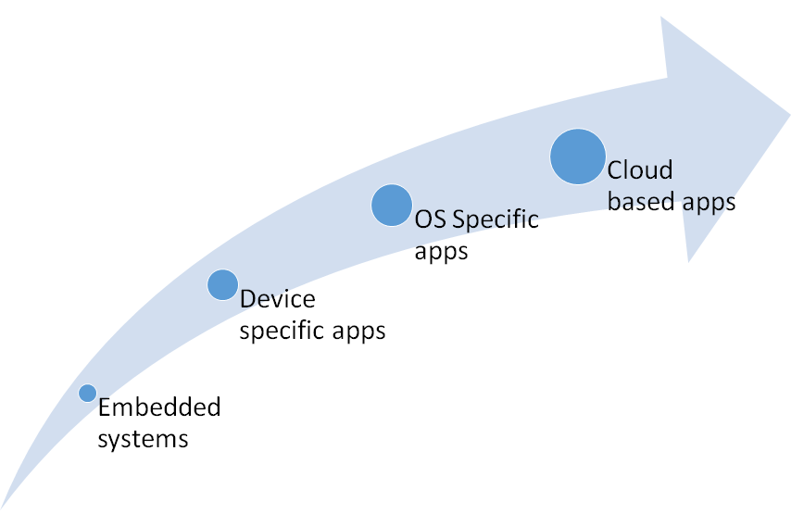
Mobile Application Development Framework

Slide 39
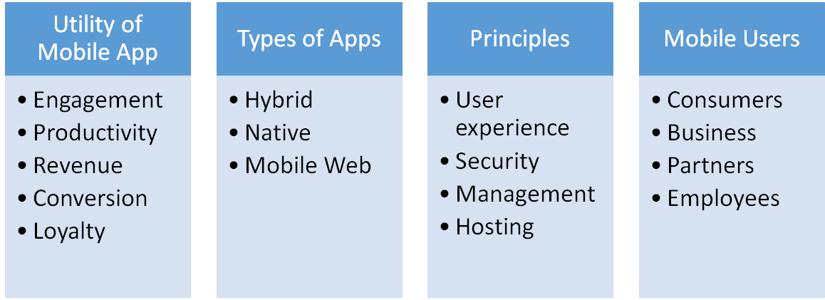
CONSIDERATIONS AND CHALLENGES FOR MOBILE APP
Topic objective: To understand about the parameters and challenges to develop a mobile app

Slide 40
CONSIDERATIONS AND CHALLENGES FOR MOBILE APP
Intended utility of the mobile app
o Consumer engagement with richer user experience
o Productivity through efficient flows
o Driving incremental revenue through user stickiness
o Customer conversion
o User loyalty through targeted and personalized offers
App Architecture
o Native vs hybrid vs web based on the requirements
o Middleware requirement for centralized configuration
o Offline vs online capability for storing data
App Development Principles
o User experience through richer controls and interactive components
o Compatibility on various devices and platforms
o Performance for each screen and task
o Security for data
o Productivity enhancement tools

Slide 41
CONSIDERATIONS AND CHALLENGES FOR MOBILE APP
Target users
o Consumers for B2C apps
o Business for Business to Business (B2B) apps
o Partners for B2B apps
o Employees for Business to Employee (B2E) apps
Testing
o Device testing
o Performance testing
o Various testing scenarios

Slide 42
CHALLENGES FOR MOBILE APP
• Diversity of devices and heterogeneous technologies: There are various mobile platforms and devices. The app should provide optimal experience in all the scenarios.
• Security:
Mobile app should ensure data security during transmission and during storage.
• User experience: Mobile app should provide optimal user experience leveraging the device capabilities to provide highest engagement possible.
• Network: Mobile app should be designed to work in regions with network, latency and bandwidth challenges.
• Compliance to diverse standards, OS, mobile platforms and devices.

Slide 43
DAILY QUIZ 3
Define the term target users.
When was the first cell phone launched
Hybrid, Native and Mobile Web are …………… of mobile apps.
Full forms of the following:
B2B, B2C, B2E

Slide 44
Types of Applications
Topic objective: To understand about the types of mobile applications
PC BASED APPLICATIONS
Personal Computer (PC) based applications are software programs developed to run on specific operating system and hardware platforms.
There are mainly two types of PC based applications:
Standalone PC Applications
Standalone PC applications are independent software programs which would run on an OS. These applications do not typically use network resources or support multi-user mode. Utility programs such as word processor, calculators, and media players fall into this category. Each of the applications had a good user interface for the PC user to interact.

Slide 45
Types of Applications
Client server applications
In client server applications, each terminal PC had a client software which is connected to a centralized server software. The client program would get input from the end user and would submit the details to the server software through a dedicated session established through the network. These applications were also referred to as “thick clients”.
Examples: Database software, networked games, banking software, network file system
WEB BASED APPLICATIONS
Internet enabled applications that are mainly rendered on desktop browsers are categorized
as web applications.
Most of the modern web applications follow layered Model-View-Controller (MVC)
architecture which supports loose coupling and flexible modular components.
a web application has 3 tiers: a web browser, the server and database server
A client-server software is menu-driven while a web program is URL-driven

Slide 46
Types of Applications

Slide 47
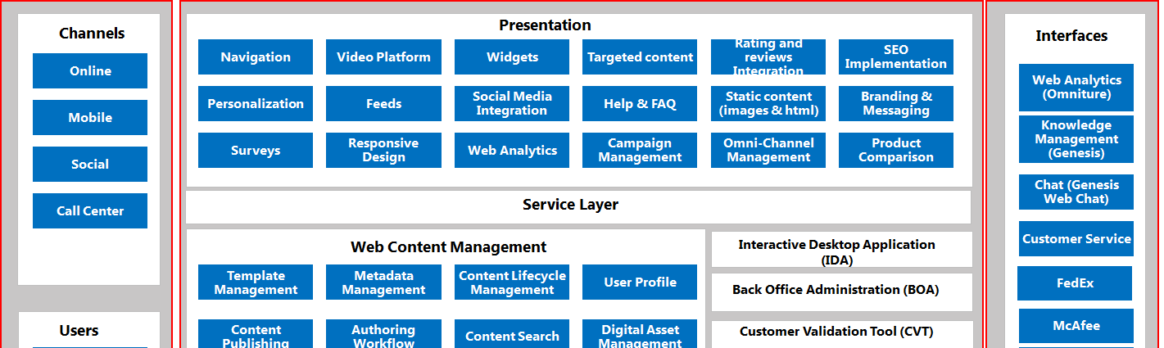
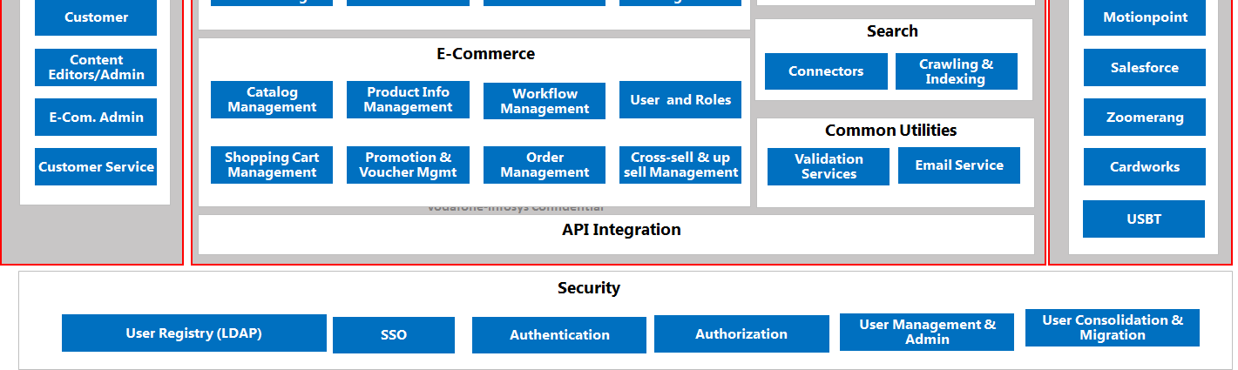
N-tier Enterprise Web Application

Slide 48
Mobile App Vs Web Application
Criteria | Web Application | Mobile App
User experience | Provides good experience optimized for desktop browsers. | Mobile apps can leverage full device capabilities and offer rich experience to users. Mobile apps provide rich branding experience to users.
Performance | Web applications provide good performance based on performance optimizations. | Native mobile apps provide high performance.
Location awareness | Web applications provide relatively less location awareness | Mobile apps provide location sensitive and contextual information
Access mechanism | Web applications are mainly accessed by desktop browsers and mobile browsers. | Mobile apps are accessed by mobile browsers and mobile devices.
Interactivity | Web applications provide interactive interfaces through widgets. | Mobile apps offer high level interactivity through touch interface.
Applicability | Web applications are normally used as Information display platforms | Gaming, location-specific applications such as car rental apps, store locator apps, reporting apps.

Slide 49
MOBILE APP PLATFORMS
Topic objective: To understand about the various platforms for mobile applications
Android
Android is an open-source mobile development platform that is based on Java and is maintained by Google.
The key features supported by Android are
SQLite based light-weight storage, SMS and MMS messaging, multi-lingual support, mobile browser. Other key features are multi-touch support, multitasking, voice features, external storage and such.
Android development needs Android SDK, libraries, emulator and Eclipse IDE. Testing can be done using Android testing APIs. We can deploy Android apps to Google Play store.

Slide 50
MOBILE APP PLATFORMS
Apple iOS
iOS is the mobile OS for Apple devices. The development on iOS happens using objective C.
iOS supports many features such as iMessage, iCloud, Siri etc. iOS provides in-built apps such as mail, notifications, contacts calendar,
bookmarks, sync etc.
iOS development includes iOS SDK (XCode), iOS Simulator, XCode IDE, and
other frameworks for building iOS apps.
For mobile web development, we could use numerous JavaScript frameworks such as SenchaTouch, jQuery Mobile, jQTouch and software such as PhoneGap that are used for mobile web development.

Slide 51
DAILY QUIZ 4
Standalone PC applications are independent software programs which would run on an OS. (T/F)
Database software, networked games, banking software, network file system are example of which application.
Difference between mobile and web applications
Name the different mobile app platform.

Slide 52
ARCHITECTURE OF A MOBILE
APPLICATION
Topic objective: To understand about the architecture of mobile applications
Mobile applications can be classified into mainly 3 categories:
Browser based mobile web apps: These are pure web applications that are designed using responsive web design techniques that can cater to variety of devices and form factors.
Native mobile apps: These apps are built for specific mobile platforms (such as iOS, Android) that can fully leverage the device capability. Normally native mobile apps are built using SDKs provided by mobile platforms.
Hybrid apps: These apps can be developed using web technologies such as JavaScript and can also partially leverage the device capabilities using a web to native layer.

Slide 53
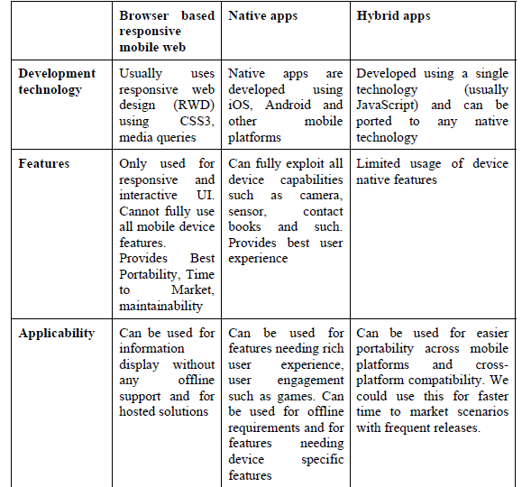
ARCHITECTURE OF A MOBILE
APPLICATION

Slide 54
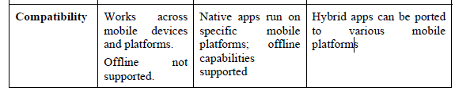
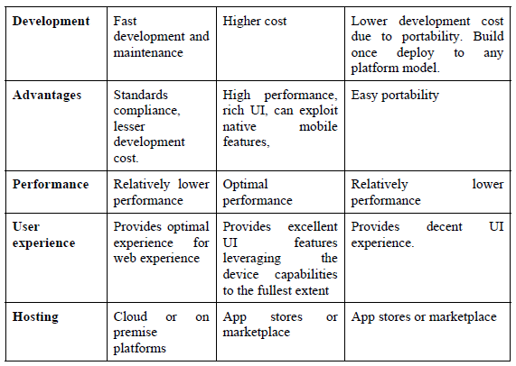
ARCHITECTURE OF A MOBILE
APPLICATION

Slide 55
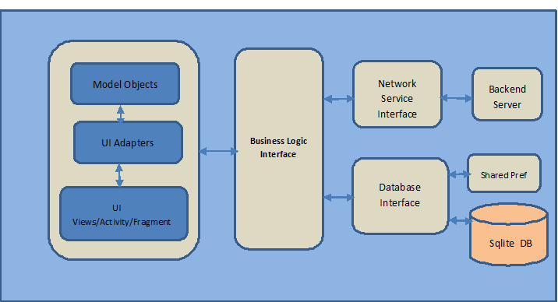
Architecture of Android based native Mobile App

Slide 56
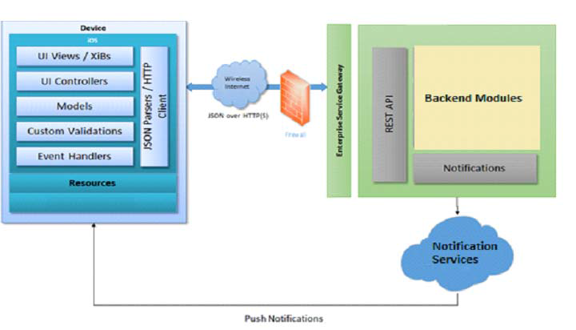
iOS based native Mobile App

Slide 57
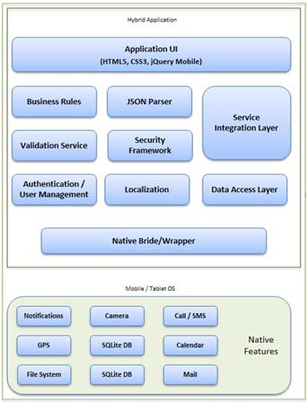
Architecture of a hybrid Mobile App

Slide 58
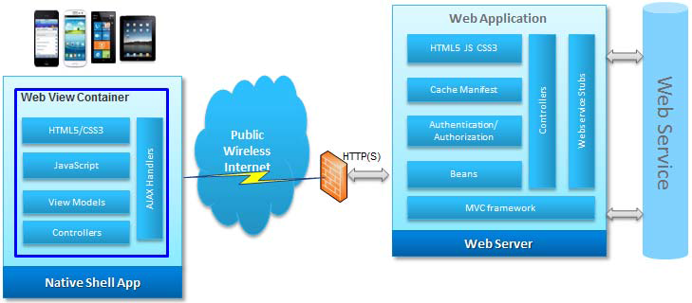
End to End Flow of a hybrid Mobile App

Slide 59
DAILY QUIZ 5
Tell the examples of browser based apps.
Tell the examples of native based app.
Can hosting be done on cloud platforms. (T/F)
Are controllers the part of native shell app. (T/F)

Slide 60
Achieving Quality Constraints
Topic objective: To understand about the quality constraints of mobile applications
Quality of mobile application depend upon performance, usability, security, availability and modifiability.
Performance in app
Performance of app plays important role in getting 5 star rating in all marketplaces like playstore, app store or windows store.
If application takes more then 10 seconds to load then it will not be used by users.
If application takes too long time to process data then it will not be used by users.
If application takes too long time to switch between screens then it will not be used by users.
The performance of app is important factor which decides the success of app.

Slide 61
Achieving Performance
Understand your target device.
Most developers forget about device, they classify device based on operating system, but forget about configuration of devices.
Always classify devices based on specification sheet.
Try developing apps based on low specification mobile which will automatically run in all mobiles.
Understand your tools
Try to understand the tools that is used to develop the mobile app.
Better understanding of tools helps to make important architectural design.
Understanding about phone gap helps to develop app for multiple platforms.

Slide 62
Achieving Quality Constraints
Quality of mobile application depend upon performance, usability, security, availability and modifiability.
Usability in app
Usability enables the users to easily navigate between different parts of the app.
The proper links to various parts of app helps to improve the usability of app.
Ex – If the user reaches end of single screen then placing top button or next button helps to navigate to top of page or next screen.
The best usability practice helps to acquire more customers to app.

Slide 63
Achieving Usability
Use a task based design
Add a sticky menu with search option
No dividers needed
Use short forms
Tone it down
Don’t use too many font sizes
Optimize for speed
Switch to desktop site and back
Test your Mobile UX again and again

Slide 64
Achieving Usability
Use a task based design
Always design app based on user needs. The app users opens your app to do some task on the go.
The home screen should provide option to do task that user want to do in your app.  Add a sticky menu with a search option
Users always want menu with search option in all places.
Place a sticky menu that will automatically fits during page navigation.
No Dividers needed
Don’t use dividers which adds line in UX which creates negative experience.
Place elements in good order instead of divider.

Slide 65
Achieving Usability
Use short forms
The size of any data entry form should be limited to 3 to 4 elements. If its long like desktop site then user navigate to other app.
Ex : If a user wrongly enters password then instead of loading a new form to create a user just change the button to register and create user with minimal data.
Tone it down
The minimal use of colors will create positive UX.
The multicolor UX confuses the user.
Button hit areas
Most users click buttons using thumbs, so place the button that is easily accessible using thumb.

Slide 66
Achieving Security
How to protect app from hackers
Trusting build in platform security
The common mistake done by developers are trusting build in platform security but lot of security holes are there in platform.
App developers should use third party security mechanism to protect the app.
Using code from other developer
It take time to build complete app from scratch, so some developers use code from internet.
Hackers create certain codes and publish in internet to get access into your mobile app users.

Slide 67
Achieving Security
Not planning for data caching vulnerabilities
The hackers tries to read the cache information through other app.
The apps like free games are created to hack the users mobile.
The data cache should be secured using password or some other way to protect the data.
Before launching app to market perform all security testing.
You can hire a ethical hackers for security testing.
Not Implementing Secure Communications to Servers.
You should establish connection to server only through secured protocols like https.
If you fail to do then it is easy to hack the server using path tracing or reading mobile traffic through proxy.
Patching Your App Too Slowly
Frequent security update of app increase the hacking time.

Slide 68
Achieving Availability
Availability refers to continuous working of application in both offline and in online mode.
Today mobile users are travelling across multiple cell sites which frequently disturb the wireless internet connectivity to mobile.
This interruption should not affect the mobile app.
It is possible to achieve high availability by effectively managing offline data.
You can also provide high availability by giving effective synchronization mechanism

Slide 69
Achieving Modifiability
Modifiability helps to release multiple version of app more easily
It is achieved by developing as multiple units instead of single unit.
If any bugs arises after launch then it is easy to modify the unit instead of changing everything in code.

Slide 70
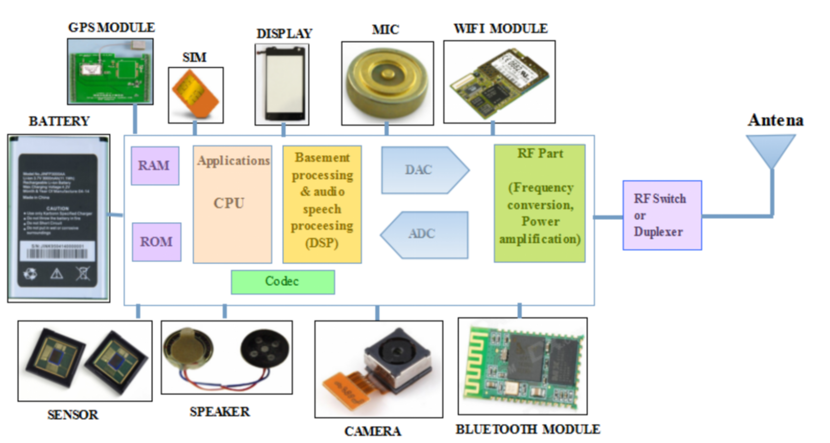
Mobile Phone Architecture

Slide 71
DAILY QUIZ 6
Name the various components used in your mobile phone.
2. Which of the following offers packet mode data transfer service over the cellular network?
TCP
GPRS
GSM
None of the above
3. Which one of the following is considered as the GSM supplementary service?
Emergency number
SMS
Call forwarding
All of the above

Slide 72
Processors used for Mobile and Handheld devices
Topic objective: To understand about the processors in mobile devices
A mobile processor is found in mobile computers and cellphones.
A CPU chip is designed for portable computers to run fanless, under 10-15W, which is cool enough without a fan.
It is typically housed in a smaller chip package, but more importantly, in order to run cooler, it uses lower voltages than its desktop counterpart and has more sleep mode capability.
A mobile processor can be throttled down to different power levels or sections of the chip can be turned off entirely when not in use.
Further, the clock frequency may be stepped down under low processor loads. This stepping down conserves power and prolongs battery life.
It is also known as chipset, is a component that controls everything going on in your smartphone and ensures it functions correctly. You can compare it to the brain of the human body.
Every action you perform on your smartphone goes straight to the processor. These actions are then converted to visual changes on your screen, and all of this happens in a split second.

Slide 73
Processors used for Mobile and Handheld devices
Processor speed
The speed at which a processor processes a certain action depends on a number of factors, like the number of processor cores.
The clock speed is another important aspect.
Processors with low clock speeds and (sometimes) a smaller number of processor cores work more slowly than processors with high clock speeds and a large number of processor cores.
Makes sense, as that's what you're paying for, in the end.
Actions performed on a cheaper smartphone will be processed more slowly than on a more expensive model.

Slide 74
Processors used for Mobile and Handheld devices
Mobile devices with Qualcomm Snapdragon processors
Mobile Devices and Processor
HTC and 600-800 MHz
Samsung Galaxy Ace Plus, Nokia Lumia 610 and 800-1000 MHz
HTC Desire S, HTC Incredible S, Sony Xperia ARC and 1 GHz
Blackberry Bold 9900, Blackberry Torch 9860 and 1.2 GHz
HTC Titan, Nokia Lumia 800, Samsung Galaxy S Plus and 1.5 GHz
Samsung Galaxy S 2 1.2 GHz Dual Core

Slide 75

Processors used for Mobile and Handheld devices
The clock speed determines how many instructions the processor can execute per second. A processor with a 1-Gigahertz (GHz) clock speed can process 1 billion instructions per second.
The general rule is that higher clock speeds make for faster phones.
You can often see this with more expensive smartphones.
Their processor cores have higher clock speeds than those of more affordable devices.
The number of processor cores also influences the speed of your smartphone.

Slide 76
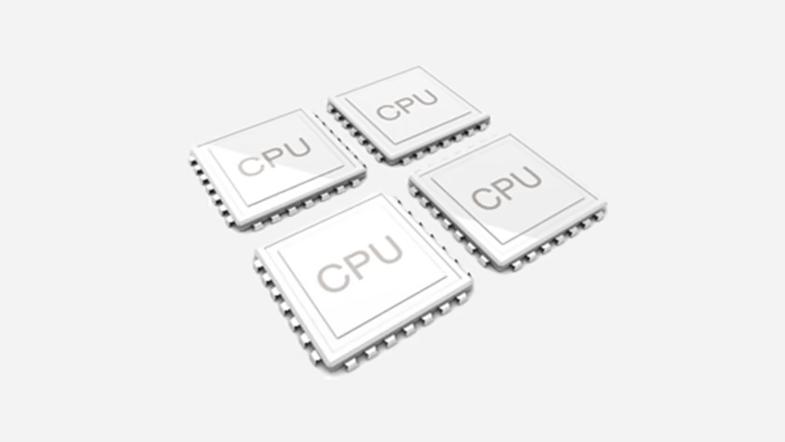
Processors used for Mobile and Handheld devices
Processor Core
A processor, also known as CPU, consists of multiple cores: Dual, Quad, Hexa, and Octa core. What do these cores do exactly?
Processor cores distribute the work that comes in when you use your phone. One core has a maximum number of instructions it can process within a certain amount of time.
If you perform a lot of actions on your smartphone, a queue of sorts will form. If this queue gets too long, part of it will go to the next core. This ensures your smartphone will keep functioning smoothly.

Slide 77
DAILY QUIZ 7
A processor with a 1-Gigahertz (GHz) clock speed can process 1 billion instructions per second. (T/F)
Name the various multiple cores.
Processors with low clock speeds and (sometimes) a smaller number of processor cores work more slowly than processors with high clock speeds and a large number of processor cores. (T/F)
A processor with a 1-Gigahertz (GHz) clock speed can process 1 billion instructions per second. (T/F)

Slide 78
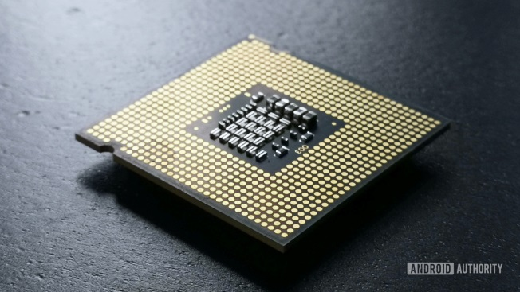
SoC Architecture
The term System-on-Chip refers to the chip housed in your mobile device, which pretty much functions as a complete computer.
Now while desktop systems have a separate processor, separate GPU (except for those systems with integrated processors), separate controllers to handle the peripheral devices and so on, that is not the case with mobile devices such as tablets and cellphones.
All of the discrete components seen on the desktop need to be integrated within one single chip and that implementation is called as the System-on-Chip (SoC).
Example
Arm, Huawei, Qualcomm, Samsung, MediaTek, and
Others.

Slide 79
SoC Architecture
Topic objective: To understand about the software architecture of mobile applications
Central Processing Unit (CPU) — The “brains” of the SoC. Runs most of the code for the Android OS and most of your apps.
Graphics Processing Unit (GPU) — Handles graphics-related tasks, such as visualizing an app’s user interface and 2D/3D gaming.
Image Processing Unit (ISP) — Converts data from the phone’s camera into image and video files.
Digital Signal Processor (DSP) — Handles more mathematically intensive functions than a CPU. Includes decompressing music files and analyzing gyroscope sensor data.
Neural Processing Unit (NPU) — Used in high-end smartphones to accelerate machine learning (AI) tasks. These include voice recognition and camera object segmentation.
Video encoder/decoder — Handles the power-efficient conversion of video files and formats.
Modems — Converts wireless signals into data your phone understands. Components include 4G LTE, 5G, WiFi, and Bluetooth modems.

Slide 80
Mobile Software Architecture
It is a set of structural elements and their interfaces from which the system is composed, as well as their behavior in the framework of all structural elements.
It can be said that this is the skeleton of a program, and the whole work of the mobile application is determined by its quality.
By missing an important element in creating a mobile app architecture, you endanger the success of your project.
The complexity of building high-quality architecture depends on the size of the application.
The proper architecture will allow for saving a lot of time, energy, and costs in the future.

Slide 81
Mobile Software Architecture
The Presentation Tier is what you see on your device screen.
It contains components for the user interface (UI), along with the components necessary for UI processing.
The presentation layer is accessed through a browser or web app, and displays graphical and text content to the user.
It interacts with other layers via an application programming interface (API).
Hybrid apps use HTML, JS, and CSS.
It is regulated via UI component layout, visual design, and branding matters: each aspect should be attended by a professional UI designer, so the whole layer performs in the best possible way.
Another important component of the presentation layer is UX (user experience): it’s based on user personas, user stories, user research, and usability testing processes—it involves business analysts or experienced product managers that conduct user behavior analysis.

Slide 82
Mobile Software Architecture
The Business Tier, aka application tier, is on the server-side.
It supports the mobile application but is not the app itself.
This tier encompasses the app’s functional business logic that allows the application to perform.
The key processes that belong to this layer include security, data caching, logging, data validation, exception management, and some others.
For the application layer, developers like to use Java, .NET, C#, Python, and C++, among others.
The application tier is normally hosted on one or more application servers or in the cloud.

Slide 83
Mobile Software Architecture
The Data Tier houses the app’s database and data access layer, hosted in the cloud or on-premises.
This layer covers all types of data transactions via API and data access components, service tools, and utilities.
Also, this tier is responsible for networking communication, routing, error reporting. Popular data storage systems include MySQL, Oracle, PostgreSQL, Microsoft SQL Server, MongoDB, and others.
. A 3-tiered architecture helps speed up product development, produces scalable products, and enhances your mobile app’s performance.

Slide 84
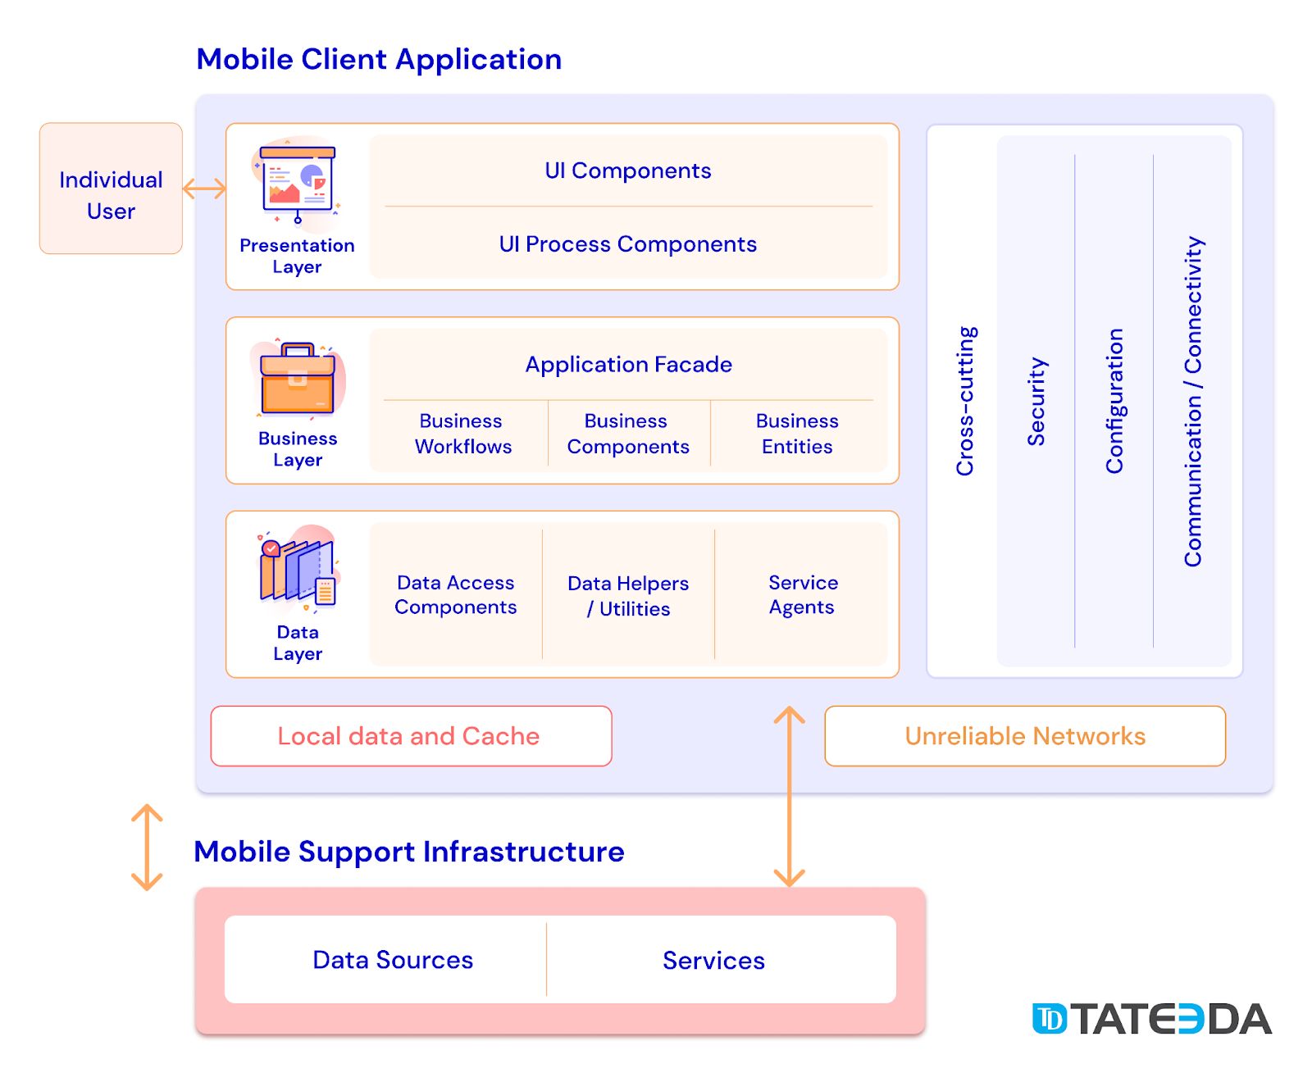
Mobile Software Architecture
https://tateeda.com/blog/fundamentals-of-mobile-application-architecture

Slide 85
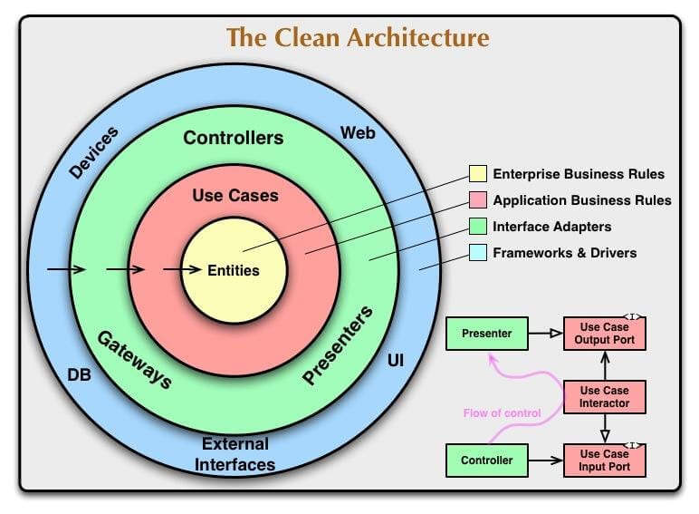
Mobile Software Architecture
https://www.intellectsoft.net/blog/mobile-app-architecture/

Slide 86
Good Architecture
Efficiency: the application performs the tasks and performs the functions in any condition. The system is effective, reliable, and copes with all the loads.
Flexibility: the chosen solution is easy to change, and errors are few. You can change one element, and it will not be fatal, influence the other one in a negative way.
Extensibility: you can add as many functions as you like to the application.
Scalability: time for development and updates decreases. The solid architecture allows you to direct development in several parallel threads.
Testability: The architecture for mobile application is easily tested, which means that the number of errors decreases and its reliability increases.
Understandability: the code should be understandable to as many developers as possible. A lot of people are working on the application. A good architecture allows beginners to understand the project quickly.

Slide 87
Real Time OS
RTOS, repeated tasks are performed within a tight time boundary, while in a general-purpose operating system, this is not necessarily so.
An RTOS is a critical component for ensuring predictable and timely execution on embedded devices such as those used in IoT, Robotics, and mobile.
Predictability and determinism, in this case, go hand in hand: We know how long a task will take, and that it will always produce the same result.
RTOSes are subdivided into “soft” real-time and “hard” real- time systems.
Soft real-time systems operate within a few hundred milliseconds, at the scale of a human reaction.
Hard real-time systems, however, provide responses that are predictable within tens of milliseconds or less.

Slide 88
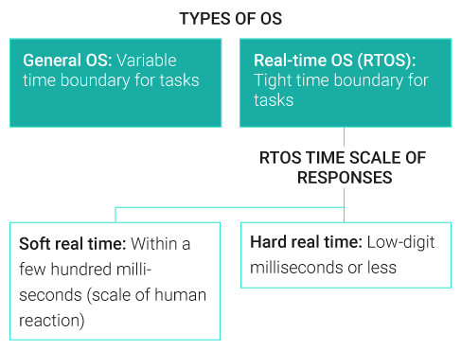
RTOS
https://www.windriver.com/solutions/learning/rtos

Slide 89
5 CHARACTERISTICS OF AN RTOS
Determinism: Repeating an input will result in the same output.
High performance: RTOS systems are fast and responsive, often executing actions within a small fraction of the time needed by a general OS.
Safety and security: RTOSes are frequently used in critical systems when failures can have catastrophic consequences, such as robotics or flight controllers. To protect those around them, they must have higher security standards and more reliable safety features.
Priority-based scheduling: Priority scheduling means that actions assigned a high priority are executed first, and those with lower priority come after. This means that an RTOS will always execute the most important task.
Small footprint: Versus their hefty general OS counterparts, RTOSes weigh in at just a fraction of the size. For example, Windows 10, with post-install updates, takes up approximately 20 GB. VxWorks®, on the other hand, is approximately 20,000 times smaller, measured in the low single-digit megabytes.

Slide 90
Examples of RTOS
.
clearAnimation()
This method will clear the animation running on a specific view.
A&D | Telecom | Transportation | Medical | Manufacturing
Flight display controller Engine turbine Drones Extraterrestrial rovers | 5G modem Satellite modem Base station | Functional safety systems Emergency braking systems Engine warning systems | Magnetic resonance imaging Surgery equipment Ventilators | Factory robotics systems Safety systems Oil and gas vibration monitors

Slide 91
SDK Architecture
.
The architecture is designed to be highly extensible. Abstract product and component classes are used so applications can control different products with the same code. Features that are not consistent across all generations of supported products can be queried at runtime, and those that are consistent will simply work.
For example, the large majority of features of the Phantom and Inspire series of products are consistent. Therefore an application written to support the Phantom 4 will, with the exception of unique Inspire 1 features, fully support the Inspire 1.
This also means when new products are released, they will already work with existing applications (when that application is rebuilt with the latest SDK that supports the new product). Any new features of the new product will need to be added to the application, but all existing features will not need modification.

Slide 92
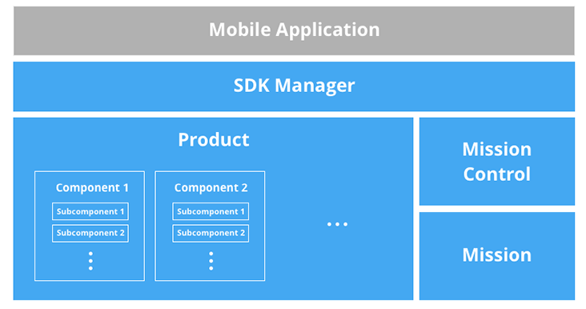
SDK Architecture
.
.

Slide 93
SDK Architecture
.
SDK Manager: Manages registration of the SDK, product connection and provides access to the product itself.
Product: The aircraft or handheld product, this class holds basic product properties and contains the main product components.
Component: Component classes describe the gimbal, camera, flight controller, remote controller and wireless link. The classes provide component control, state information and contain subcomponents.
Mission: Classes that describe different missions such as Waypoint and ActiveTrack missions and hold their setup properties and status.
Mission Control: Mission Control handles execution of missions. Either single missions can be run through dedicated mission operators, or a series of missions and actions can be run serially using the Timeline.
.

Slide 94
DAILY QUIZ 8
1. What kind of operating system does drone use?
2. What are the 3 types of RTOS?
3.The application tier is normally hosted on one or more application servers or in the cloud.(T/F)
4. MySQL, Oracle are used in which tier.

Slide 95
WEEKLY ASSIGNMENT
S.No. | Question
1. | Which is the most common architecture for mobile application development?
2. | What are the architecture of mobile application development?
3. | Define the various design constraints for mobile applications
4. | Analyse various requirements gathering and validation for mobile applications
5. | Evaluate difference between native, hybrid, and browser based apps
6. | Case study to know about the architecture of your personal mobile phone.

Slide 96
TOPIC LINKS
https://www.intellectsoft.net/blog/mobile-app-architecture/
https://www.windriver.com/solutions/learning/rtos

Slide 97
MCQ
Android is -
a. an operating system
b. a web browser
c. a web server
d. None of the above
2. Under which of the following Android is licensed?
a. OSS
b. Source forge
c. Apache/MIT
d. None of the above

Slide 98
MCQ
3. The advantage of using frequency reuse is
Increased capacity
b. Limited spectrum is required
c. Same spectrum may be allocated to other networks
d. All of the above
4. Delay in handoffs is caused due to
a. Weak signal conditions
b. High traffic conditions
c. Unavailability of the channel
d. All of the above

Slide 99
MCQ
5. Interference in frequency bands may lead to
a. Cross talk
b. Missed calls
c. Blocked calls
d. All of the above
6. A “glue” between client and server parts of the application.
a. Firmware
b. Middleware
c. Package
d. System Software

Slide 100
MCQ
7. MOM stands for
a. Mails oriented middleware
b. Message oriented middleware
c. Middleware of messages
d. Main object middleware
8. MIN stands for
a. Mobility In Network
b. Mobile Identification Number
c. Mobile Internet
d. All of the above

Slide 101
MCQ
9. SIM stands for
a. Subscriber Interface Module
b. Subscriber Identification Module
c. Subscriber Interface Modem
d. Subscriber Identification Modem
10. The basic GSM is based on …………………. traffic channels
a. circuit switching
b. packet switching
c. connection less
d. connection oriented

Slide 102
Glossary Questions
Explain the terms:
1. Wireless Application Protocol
2. RTOS
3. Cock speed
4. Clock frequency
5. MOBILE
6. Performance
7. Usability
8. Security
9. Availability
10. Modifiability

Slide 103
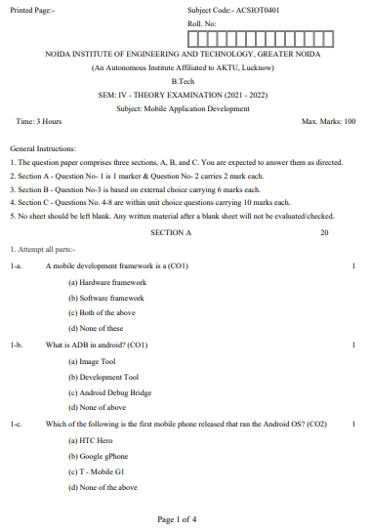
Old University Exam Question Paper

Slide 104
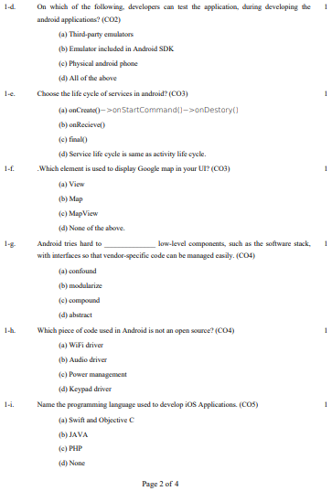
Old University Exam Question Paper

Slide 105
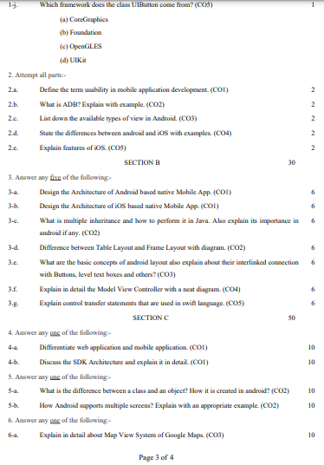
Old University Exam Question Paper

Slide 106
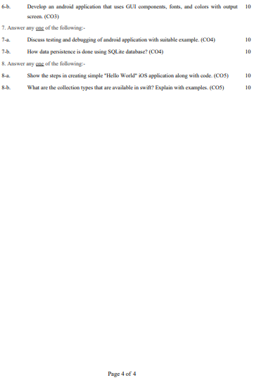
Old University Exam Question Paper

Slide 107
Expected Questions
Define mobile application development and its uses?
Discuss about the anatomy of android application
What is android? Explain their versions and applications?
Explain the types of mobile application development with examples?
Discuss on market and business drivers for mobile application development?
Explain the phases of wireless software engineering model used in publishing and delivery
of mobile application development.
7. Give the reasons to build Mobile Application.
8. Discuss Myths of Mobile Application.
9. Discuss about RTOS with suitable example?
10. Explain the design constraints that needs attention while designing mobile application?
11. Define the architecting mobile applications and user interfaces of mobile
application development with the help of suitable example.
12. Explain architecture of mobile application.

Slide 108
Recap/ Summary
Discussed about key concepts of mobile app development.
The opportunities and challenges of mobile apps.
The details of PC based apps as well as web based apps.
Content and key protocols of mobile apps
Evolution of mobile apps
Understand the software and hardware architecture

Slide 109
Noida Institute of Engineering and Technology, Greater Noida
THANK YOU !!

